Slide 1

Project 5:
Pig E. Bank objectives
Pig E. Bank is a global financial institution with a dedicated anti- money laundering compliance department.
Objectives
Determine the primary risk factors contributing to client loss and represent them using a decision tree model
Provide recommendations to increase customer retention
Methods
Exploratory data analysis
Data mining techniques
Data cleaning
Consistency checks
Data modelling
Linear regression

Slide 2
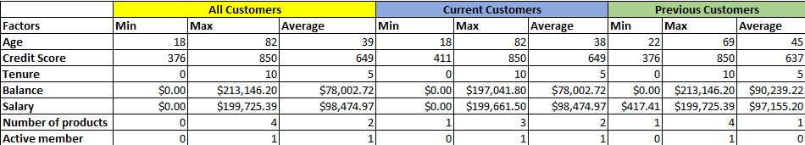
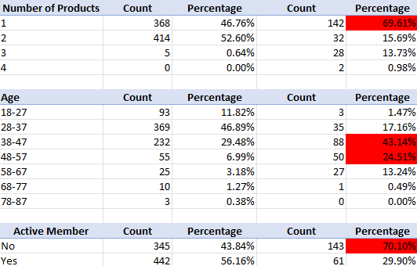
Pig E. Bank Analysis
Previous customers were at 69.61% for only having one product
Age group of previous customers with the highest percentage who left the bank
38-47 at 43.14%
48-57 at 24.51%
Previous customers were at 70.10% for not being a active member of the bank
Current Customers
Previous Customers

Slide 3
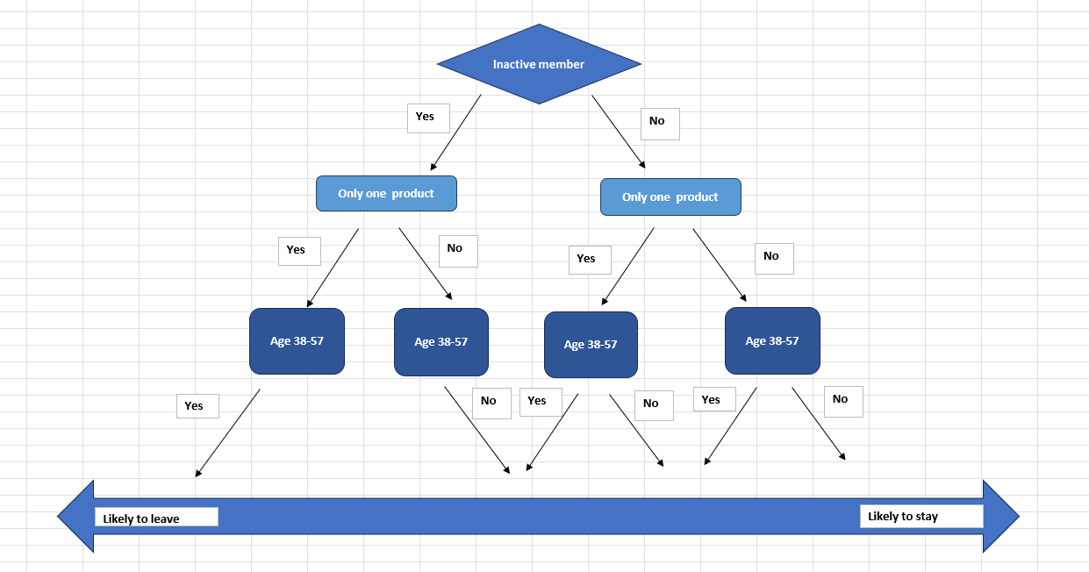
Pig E. Bank Analysis
Decision Tree
Factors determining the likelihood of a customer to leave Pig E. bank
Inactive customers are more likely to leave due to a lack of engagement or perceived value from the bank.
Customers with only one product are less likely to be loyal, as they have fewer ties to the bank.

Slide 4
Pig E. Bank Recommendations
Next Steps
Inactive customers: Implement personalized outreach, such as monthly reminders, financial health check-ups, or educational content to highlight bank products and benefits.
Offer small rewards for transactions (e.g., payback)
Promote additional products that align with customer interests to increase retention.
Increase engagement with older, high- balance customers through personalized strategies (tailored financial products like retirement accounts, long-term savings plans, or investment advisory services).
Cross- and Up-Sales, provide discounts or waived fees for activating additional services, like credit cards or investment accounts.

